Slide 1
Social Progress index -2021
_ PRITI KUMARI CHANDA

Slide 2
SPI
Calculated by analyzing the overall development
Basic human needs
Well being
Opportunities
Nutrions
Freedom to choose the life pattern etc.

Slide 3
Library used.
import pandas as pd
import numpy as np
import matplotlib.pyplot as plt
import seaborn as sns
import plotly.express as px
import plotly.graph_objs as go
from plotly.offline import iplot

Slide 4
Reading the file.
spi=pd.read_csv("spi.csv")

Slide 5
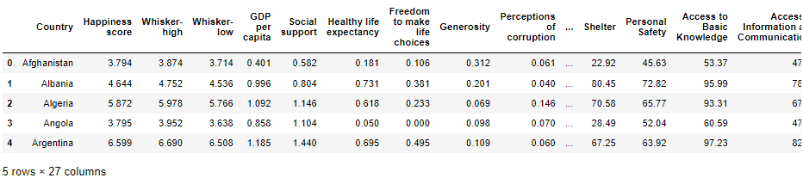
spi.head()

Slide 6
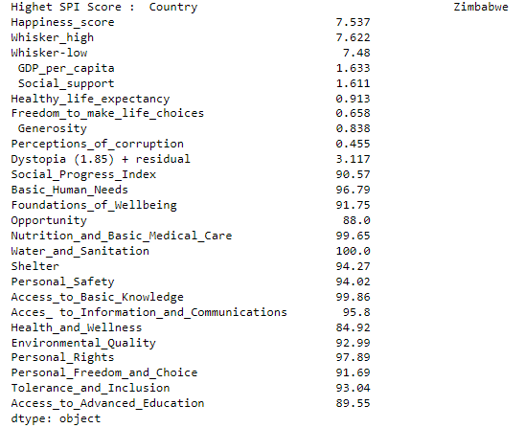
print("Highet SPI Score : ",df.max())

Slide 7
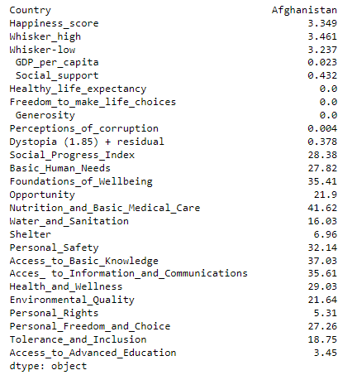
print( df.min())

Slide 8
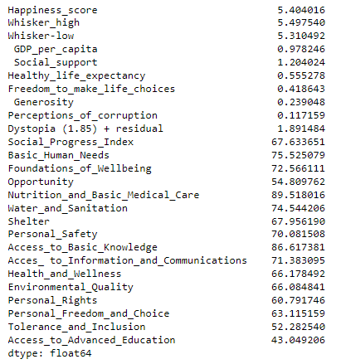
print(df.mean())

Slide 9
print(df.info())
<class 'pandas.core.frame.DataFrame'> RangeIndex: 126 entries, 0 to 125 Data columns (total 27 columns):

Slide 10
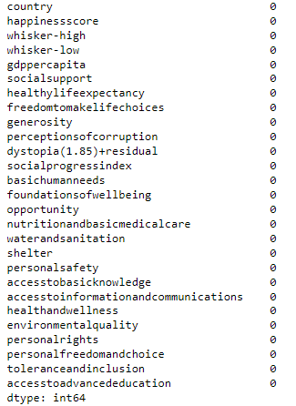
spi.isna().sum()

Slide 11
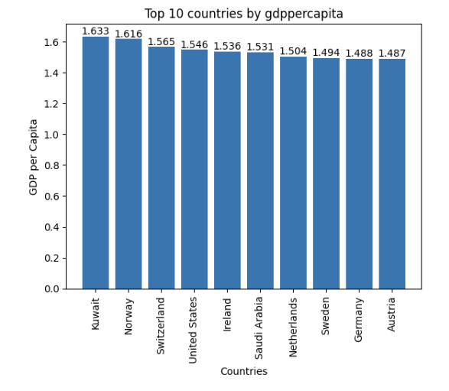
Top 10 Countries by GDP per Capita
df1=spi[['country','gdppercapita']]
top_n1=df1.sort_values('gdppercapita', ascending=False).head(10)
fig,ax=plt.subplots()
bar1=ax.bar(top_n1['country'],top_n1['gdppercapita'])
for bars in ax.containers:
ax.bar_label(bars)
ax.set_title('Top 10 countries by gdppercapita')
ax.set_xlabel('Countries')
ax.set_ylabel('GDP per Capita')
plt.xticks(rotation=90)
plt.show()

Slide 12
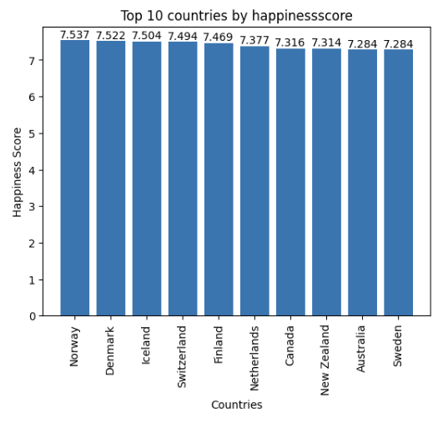
Top 10 Countries by Happiness Score
df2=spi[['country','happinessscore']]
top_n2=df2.sort_values('happinessscore', ascending=False).head(10)
fig,ax=plt.subplots()
bar1=ax.bar(top_n2['country'],top_n2['happinessscore'])
for bars in ax.containers:
ax.bar_label(bars)
ax.set_title('Top 10 countries by happinessscore')
ax.set_xlabel('Countries')
ax.set_ylabel('Happiness Score')
plt.xticks(rotation=90)
plt.show()

Slide 13
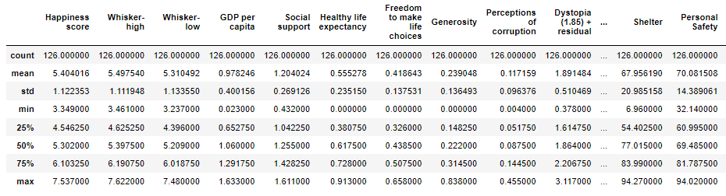
spi.describe()

Slide 14
THANK YOU

